Slide 1
Update on CAS Strategic Initiatives
Steve Armstrong
October 30, 2020
CANE Fall Meeting

Slide 2
Agenda
Update on CAS Membership and Demographics
University Engagement
Diversity Initiatives
Basic Education Initiatives
International Initiatives
The CAS Institute
Your Comments and Questions
Notes:
I’m here to provide an update from CAS leadership, and here’s what I plan to cover today.
[Walk through list]
I also really want to hear from you…What you’re excited about or maybe concerned about regarding our strategic initiatives.
If you have a question, please ask it, and note that I will reserve time for dedicated Q&A at the end of the presentation.
If you have additional questions or feedback you’d like to share after today, please send me an email – I’m in the online CAS directory. I’d love to hear from you.

Slide 3
Update on CAS Membership and Demographics

Slide 4
CAS Membership Statistics
9,241
Notes:
There is no doubt that we are a growing society. As you can see here, the CAS has enjoyed a 5% annual membership growth rate over the past decade and more.
Also note that we’re adding about 1,000 members every four years. That’s tremendous growth! We currently have over 9,000 members, which makes the CAS the third-largest actuarial organization in the world among those who credential actuaries through examinations.

Slide 5
CAS Membership Statistics
Notes:
With our strong recent membership growth, our demographics are changing, as you’d expect, and we thought you’d be interested in seeing how the CAS is growing younger. This chart compares the ages of CAS members from 2015 to 2020, and you can see that CAS membership has grown younger, on average, over the past five years.
What does this mean for the CAS? You will start to see the changing demographics across the CAS, including at the leadership level. In fact, last year we elected one of the youngest Board members to serve on the CAS Board. We also see this within our committees, with new members jumping into our rich volunteer culture and bringing fresh ideas to our committees. We even have formed a New Members Advisory Committee to ensure we serve the needs of the younger demographic, and we’ve developed a New Members Award to recognize new members who are making significant volunteer contributions.

Slide 6
CAS Examinations
5,871
See 2019 CAS Annual Report for more details.
Notes:
So where are all of these new members coming from? They’re coming through our exam system, of course. So it should not surprise you to see the year-after-year growth in the number of candidates sitting for CAS examinations. There was one slight dip, in 2016, with fewer candidates sitting for exams during the transition from Exams LC and ST to Exam S.
In 2018, we administered over 7,000 exams, the first time we ever exceeded that threshold, and in 2019, we exceeded 8,000, another record.
This year, of course, with the cancellation of our Spring Exams, our numbers are down.

Slide 7
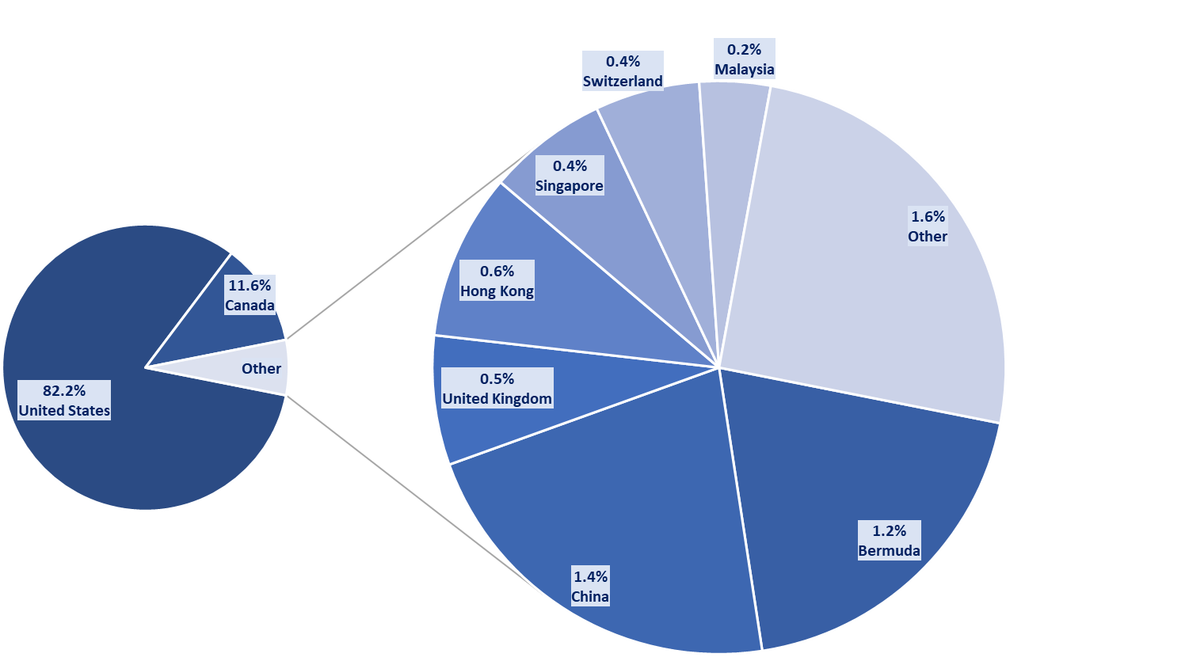
A Global Society
Notes:
The CAS is increasing its global reach – while 82% of CAS members live in the United States and 12% in Canada, the remaining 6% are distributed across the rest of the world. Of the members who are outside North America, you can see that the majority of them are not in any one country, but spread over a lot of different countries, mostly in the Asia-Pacific region, with 1.4% of our members in China.

Slide 8
CAS Membership – Asia
Notes:
To that point, I’d like to share two additional charts that demonstrate our growth in the Asia-Pacific region. This first chart shows our membership growth. In Asia-Pacific, our membership has grown from 58 members in 2004 to 299 in 2020.

Slide 9
CAS Examinations – Asia
Notes:
And finally, exam registrations in Asia have also shown strong growth. Furthermore, in 2019, while 3% of our Members were in Asia, 11% of our exam registrations were in Asia, indicating that the pipeline is bringing along significant numbers of future members.
And please note, these numbers are only the CAS-specific exams, and do not include students taking the preliminary SoA exams.

Slide 10
CAS Envisioned Future
Notes:
So as I’ve described, despite COVID-19, the CAS is thriving. Our membership is growing, the numbers of candidates taking our exams is growing, and attendance of our professional education programs is also expanding, with 2019 attendees increasing 55% over 2018.
Transformation and reinvention are best accomplished when an organization is in a position of strength. Accordingly, now is the ideal time for the CAS to look over the horizon at a new Envisioned Future that will allow us to maintain our role as the leading international organization for credentialing and professional education for our future and current members.

Slide 11
CAS Strategic Plan Development Timeline
Nov 2019 – May 2020
May 2020 – Present
Board develops and adopts new Envisioned Future, which forms the basis of a new Strategic Plan
CAS Leaders and Staff develop 3-Year Plans, which outline problems that need to be addressed to achieve the CAS’s Envisioned Future
Next Steps
Board to formally adopt new Strategic Plan on Nov 2
Strategic Plan to be released to members in conjunction with Annual Meeting on Nov 9
Volunteers and Staff begin executing 3-Year Plans
Notes:
And that’s what the Board has been working on over the past year…
Here is a timeline of the development of a new Strategic Plan…
The Strategic Plan was last refreshed in 2017 and is typically reevaluated every five years. However, given all of the changes occurring in our industry and the world at large, the Board revisited our plan two years ahead of schedule, to look ahead to our new envisioned future.

Slide 12
Envisioned Future
Current Envisioned Future (2017 CAS Strategic Plan):
The CAS will be recognized globally as the premier organization advancing the practice and application of casualty actuarial science and educating professionals in casualty actuarial practice.
CAS members are sought after globally for their insights and ability to apply analytics to solve insurance and risk management problems.

Slide 13
Envisioned Future
Current Envisioned Future (2017 CAS Strategic Plan):
The CAS will be recognized globally as the premier organization advancing the practice and application of casualty actuarial science and educating professionals in casualty actuarial practice.
CAS members are sought after globally for their insights and ability to apply analytics to solve insurance and risk management problems.
Notes:
So let me draw your attention to key parts of the Envisioned Future:
* Making members sought after for their ability to solve problems
* And expanding globally
So as I walk through the remainder of the presentation, I’d like to think of our different strategic initiatives in that context

Slide 14
Notes:
So how do we make our members sought after? Well, it begins by diversifying our pipeline and attracting high-potential young professionals into our community who love to solve business problems with data and analytics.
And I want to tell you about a program we completed over the summer that will help us do that going forward – the CAS Student Central Summer Program…

Slide 15
Late March/Early April
Surveyed CAS University Liaisons
Late April/May
Developed Program
Announced Program (May 22)
Discussions with Professors
Surveyed Students
Sourced Volunteers
Application Deadline (June 1)

Slide 16
631
Student Applications Received
176
Admitted into program due to cancelled internship
455
Invited to participate in CAS Student Central Independent Summer Program

Slide 17
8 weekly modules (June 15-August 7)
P&C Topics (Ratemaking, Reserving, Predictive Modeling, Data Visualization)
Technical and Soft Skill Development (Excel, Presentation, Interview, Networking)
Weekly mentor/student cohort videoconferences
Culminates with a case competition
Participants to be Awarded Certification of Completion

Slide 18
Week | Monday | Topic
1 | 15-Jun | Intro to P&C and Basic Technical Skills (Excel)
2 | 22-Jun | Data Visualization
3 | 29-Jun | Week of July 4th (Case Competition Released)
4 | 6-Jul | Pricing
5 | 13-Jul | Reserving
6 | 20-Jul | Predictive Modeling
7 | 27-Jul | Presentation Skills, Resume, Interview Prep
8 | 3-Aug | Finalize Case Competition and Presentations

Slide 19
Mondays: Live webinar on assigned topic at 1 p.m. ET/12 p.m. CT/10 a.m. PT (recorded for those unable to make scheduled time)
Tuesday/Wednesday:
Work through assignments including watching other recorded presentations
Optional Student Cohort Meetings
Thursday or Friday: Mentor and student cohort weekly videoconference (up to one hour)

Slide 20
6 weekly modules (June 29-August 7)
P&C Topics (Ratemaking, Reserving, Predictive Modeling, Data Visualization)
Technical and Soft Skill Development (Excel, Presentation, Interview, Networking)
Notes:
And here is an overview of the Independent Summer Program…

Slide 21
Actuarial Inclusion, Equity and Diversity CAS Regional Affiliates - Fall 2020
Notes:
As a profession, we seek to increase our diversity along the lines of ethnicity, race, gender, nationality, background, and thought. To that end, we’ve committed to increasing our outreach efforts and making diversity, inclusion, and equity a particular focus in our new Strategic Plan.

Slide 22
JOINT COMMITTEE FOR INCLUSION, EQUITY & DIVERSITY
CAS Core Values
Collaboration
Community
FormerJCCEAD
Continual Improvement
Diversity
2017
Innovation
JCIED
Professionalism
Practicality
The CAS will actively ensure that we have diverse, engaged communities of professionals who gain value through the CAS’s resources, networking, skills training, career development, thought leadership and advocacy.
Notes:
Diversity and Inclusion is not a new idea to any of the organizations participating in today’s panel. While diversity efforts across the profession began, in some cases many years ago, in 2017 the CAS committed to Diversity as one of its seven Core Values and included it as a key component of our strategic plan goals around membership community, as described here.
CLICK
The JCIED was formed in 2019, in order to have a stronger more coordinated approach to DE&I across the SOA and CAS.
CLICK
We also wanted to make sure were collaborating effectively with all the other organizations working in this space. We’re proud and thankful to have representatives from International Association of Black Actuaries (IABA), Organization of Latino Actuaries (OLA), The Actuarial Foundation, and Sexuality and Gender Alliance of Actuaries (SAGAA) as members of the JCIED.

Slide 23
ADDRESSING BARRIERS JCIED WORKING GROUPS
Career Encouragement:
Addressing barriers to entry for underrepresented candidates
Awareness of the Profession
Financial Barriers
Building Networks
BeAnActuary.org
Professional Development
Educating members at conferences and webinars
Combatting Bias in Hiring
Inclusive Teams
Acting in Allyship
Networking receptions
Leadership Development
Addressing barriers to career advancement
Building a diverse leadership pipeline
Creating opportunities for skills development
CE
PD
JCIED
LD
Read more about 2017 Barriers to Entry Study:
https://ar.casact.org/new-report-holds-keys-to-diversity-and-inclusion-five-barriers-revealed/
Notes:
Also in 2017, the CAS, SOA, IABA and Actuarial Foundation co-commissioned a study on Barriers to Entry for Black/African American, Hispanic/Latinx and Native American candidates. study which helped define our areas of focus – You’ll hear more about these barriers from our IABA and OLA partners later in this session.
(Barriers to Entry - Lack of or late awareness of students and their influencers, lack of network, inadequate financial support, inadequate academic preparation, and discrimination in hiring and promotion)
The three main working groups of the JCIED each address some of those barriers.
We currently have three main working groups within the JCIED:
Career Encouragement
is focused on building early awareness of the actuarial profession among underrepresented high school and college students and their influencers as well as addressing the need for financial support for many of these students.
We do this through Actuarial High School Days, Summer Actuarial Bootcamps, and maintaining a slew of resources on scholarships and other programs on the BeAnActuary.org website
Professional Development
is focused on providing quality education to our members, especially those who are hiring or leading teams, so they can address bias and discrimination in hiring, creating inclusive work cultures, and practicing allyship.
We’re lucky that there are TONS of actuaries who are excited to bring forward topics to present at our meetings, so this working group is not only tasked with creating content, but helping others outside the committee to either develop their own content or amplify it by sharing it across other organizations or in multiple settings.
We also provide diversity networking opportunities alongside key continuing education opportunities, like our spring and annual meetings
Diversity in Leadership
is focused on ensuring opportunities for networking, development and advancement of underrepresented members towards leadership
within the volunteering structure of the CAS and SOA as well building leaders within our employers
The JCIED connects all of these working groups to CAS and SOA leadership (we have board members from both organizations on the JCIED), connects them to our partners (IABA/OLA/TAF/SAGAA, others), tracks progress and makes sure these groups have what they need to succeed, and keeps us all on top of what is going on in the industry.

Slide 24
RECENT JCIED HIGHLIGHTS
Expanded Exam Reimbursement Program
First Virtual Be An Actuary Day
Diversity in Leadership Action Plan
Actuarial Profession Demographics
Notes:
We want to draw your attention to some exciting things going on in the JCIED this year.
For many years, the CAS & SOA have offered an exam reimbursement for Black/Hispanic or Latinx/Native American candidates who take and pass exams P and FM as a way to address the financial barrier to entry. This year, we’ve brought a proposal to the SOA and CAS for expanding that program to cover two more exams. The expansion will also cover students who fail with a score a 4 or 5 - we’ve found that students from underrepresented backgrounds tend to lapse out of the exam track after failing one exam, compared to 3 failed attempts for other candidates, and this change will provide them the support to take a second and third attempt. We expect to see this expansion in place for 2021 exams.
Prior to COVID, the Career Encouragement working group spent a significant amount of time on High School Actuarial Days around the country, working to increase awareness of the actuarial profession among high school students from underrepresented backgrounds. This year, we’ve pivoted to a fully virtual program, and had our first virtual Be An Actuary Day in partnership with Arizona State University on Sept 18th. It was a great success, and we’re already looking for opportunities to expand this program going forward. This is one of the areas where we need LOTS of volunteers, and with the virtual format, it’s an incredibly simple, easy and rewarding volunteer opportunity.
The last two items are in flight
Our diversity in leadership working group has produced a set of recommendations for the JCIED, as well as the CAS and SOA individually, to push for progress in building a diverse slate of leaders in our organizations – these range from educational recommendations to changes in how we nominate candidates for leadership
The JCIED is also working producing a set of metrics which can be used to track our progress for candidates and SOA/CAS members combined across a range of dimensions of diversity. We’re hoping to have more to share on this in the coming months.

Slide 25
CAS LEADERS REAFFIRM IE&D COMMITMENT Strategic Approach to Racial Equity
Transparency and Accountability
Significant time and money invested in eliminating barriers to entry
Amplification of underrepresented voices
Notes:
The JCIED is going to keep moving and building on its work to make change collaboratively as a profession, but this summer’s events really brought home for CAS leadership that DE&I have to remain a top priority.
Check out the CAS website for more on the strategic approach https://www.casact.org/press/index.cfm?fa=viewArticle&articleID=4849
Here are a few things you can expect:
Transparency and Accountability – just as we mentioned metrics to track progress in the JCIED for the profession as a whole, the CAS has built a detailed set of metrics with which we can track progress for our own candidates and members. We’re working now on setting SMART targets to hold ourselves accountable.
Significant TIME AND MONEY invested into breaking down barriers to entry
Where it makes sense, we’ll be doing this in partnership with the other organizations through the JCIED, but also making sure CAS resources are devoted to this.
The Board, in September, approved a significant increase in funds for DE&I work – more to be announced on this later
We want to move towards stronger allyship – we recognize the huge strides that are being made by our partners, like IABA, OLA, and newly created SAGAA, and we will be bringing their work to the forefront as much as we can, so members know exactly what they can do to support their efforts and benefit from the hard work they are doing.

Slide 26
CAS DE&I ACTION PLAN
Added $120,000 investments annually to external orgs
Focus on racial justice in education
Diversity Metrics and Targets
Promoting awareness of IABA, OLA, SAGAA
Ramped up DE&I Education Opportunities
Campaign for DE&I as Professionalism topic
Diversity in Leadership at CAS Leadership Summit
Bias in Insurance Working Group
Notes:
Specific actions that support the CAS Strategic Approach
Over 40 activities to be initiated over the next year, overseen by a standing committee within the CAS Board of Directors
In addition to adopting the strategic approach to racial equity, the Board approved an additional $120,000 in new annual investments to external organizations that can support our efforts to build a diverse pipeline of future CAS members. (Organization of Latino Actuaries, Actuarial Foundation, and Orgs supporting college and university education for Black, Latinx, American Indian students). This funding is in addition to contributions the CAS has historically made to the International Association of Black Actuaries. We are actively sharing the recommendations developed by our partners, the International Association of Black Actuaries, the Organization of Latino Actuaries, and the Sexuality and Gender Alliance of Actuaries, and amplifying their voices within our community.
We have ramped up DE&I education for our members, including at this year’s CAS Annual Meeting.
We are leading a profession-wide grassroots campaign to encourage the U.S. Qualification Standards to acknowledge DE&I continuing education sessions as professionalism credits.
CAS leaders attended training on diversity in leadership and how to promote equity in our work products at the annual Leadership Summit.
We have formed a Bias in Insurance Working Group to consider the CAS’s role in industry-wide scrutiny on racial bias, discrimination, and disparate impact in insurance.

Slide 27
GET INVOLVED TODAY
Is DE&I A Professionalism Topic?
American Academy of Actuaries Exposure Draft of USQS is open for comment until Oct 30th, 2020
Read the letter from CAS President Steve Armstrong
Email comments to 2020USQSComments@actuary.org
CAS Diversity Impact Group (DIG)
Stay Informed
Make your voice heard / Share best practices
Microvolunteering opportunities, no meetings
Pipeline to JCIED
JOIN via CAS Online Community!
Notes:
Here are a few ways that you can get involved right now.
If you believe that Diversity, Equity & Inclusion education can or should be considered a professionalism topic (even if your answer is “in some cases”), let the American Academy of Actuaries know. CAS President Steve Armstrong sent a letter to the Academy urging them to make DE&I a priority as part of our US Qualification Standards, and now we need as many CAS actuaries as we can get to comment before the October 31st deadline to make our voices heard.
(If After October 31st – this is something that recently ended, but we hope that you took an opportunity to make your voice heard)
Join the CAS Diversity Impact Group
We wanted to create a way to engage with the many CAS members who are passionate about DE&I, while recognizing that the Joint Committee is limited in the number of seats we have for new volunteers
The DIG is a great way to stay informed about what’s going on in the JCIED and CAS Diversity activities
Share your opinions, ideas or best practices with actuaries across our membership
Get notified about ad-hoc or short-term volunteering opportunities without having to attend committee meetings or calls (for example the virtual Be An Actuary Days we just mentioned)
We’ll look to the DIG first for new members to join the JCIED as slots open up.
You can add yourself to the DIG by logging onto the CAS Online Community, search for Diversity Impact Group and click Join

Slide 28
GET INVOLVED WITH OUR PARTNERS
New IABA Guide – Recommendations for Employers
Sourcing, Recruiting & Hiring
Workplace Culture
Compensation & Development
Ways you can help IABA
OLA Academy
Resume Reviews
Mock Interviews
Mentoring
Sexuality And Gender Alliance of Actuaries
Networking
Professional Development
Company Education
blackactuaries.org
latinoactuaries.org
Find us on LinkedIn
Notes:
Finally, and perhaps most importantly, there are several ways to get involved in the work our partners are doing, either as a sponsor, a member, or as an active ally.
The International Association of Black Actuaries after gathering input from members, sponsors and industry partners, has released a set of recommendations for employers to increase the number of Black Actuaries in your companies. This is a comprehensive set of concrete steps you can take in your companies in the areas listed here.
Check it out at BlackActuaries.org
The Organization of Latino Actuaries just closed it’s application window for the OLA Academy, an online program to help Latinx candidates in the job search project. OLA needs tons of volunteers to help with Resume reviews, mock interviews and mentoring.
Check out all the ways you can get involved with OLA at LatinoActuaries.org
The Sexuality and Gender Alliance of Actuaries, or SAGAA, is a new group that formed this summer (2020) to support actuaries and actuarial candidates in the LGBTQ+ community
Their three pillars are around networking, professional development and company education of best practices
LGBTQ members, candidates and allies are invited to join. You can connect with them on LinkedIn to stay up to date and get involved.

Slide 29
APPENDIX – CAS DIVERSITY DATA

Slide 30
WHY PRIORITIZE DIVERSITY?
Reduce bias from our “dataset”
Profession better reflects those we serve
Grow with the market
Expand our reach to attract top talent
Maintain relevance in a crowded field
Math and STEM are outperforming Actuaries
Notes:
It’s important to note why we feel it’s important to focus on representation of racial/ethnic groups in recruiting for the actuarial profession:
Just like actuaries strive to collect unbiased data, our profession as a whole is currently a biased dataset that does not represent the customers we serve, especially within the United States – if we are able to increase diversity in our profession, we’ll also be better able to identify and address bias in our work.
The outlook for the profession is good, with continued growth – we need to expand our outreach to make sure we’re getting the best candidates interested in the profession
The profession is threatened by other careers like data science – other STEM professions are doing better at capturing diversity of talent than the actuarial profession – if we don’t catch up, we risk losing talent to other STEM fields and losing relevance as a profession.

Slide 31
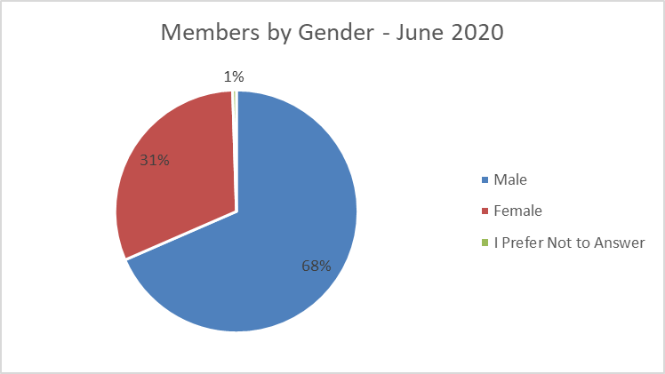
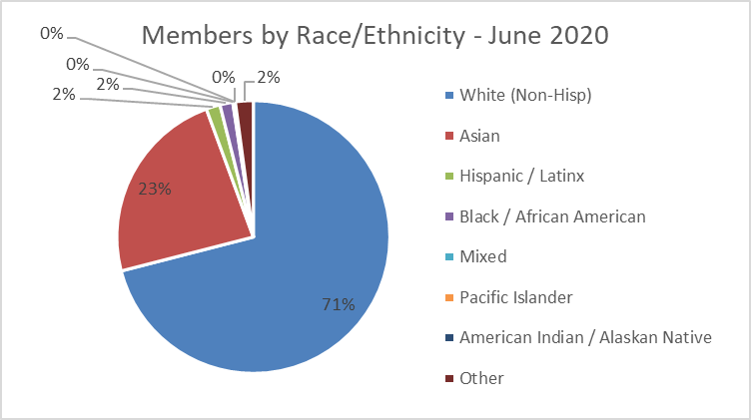
CAS Member Demographics
Notes:
31% of our membership is female.
Of those that report race/ethnicity (75% of ALL members report, 90% of new members in the last 10 years report) - Only 2% of our membership is Black, and 2.5% is Hispanic or Latinx

Slide 32
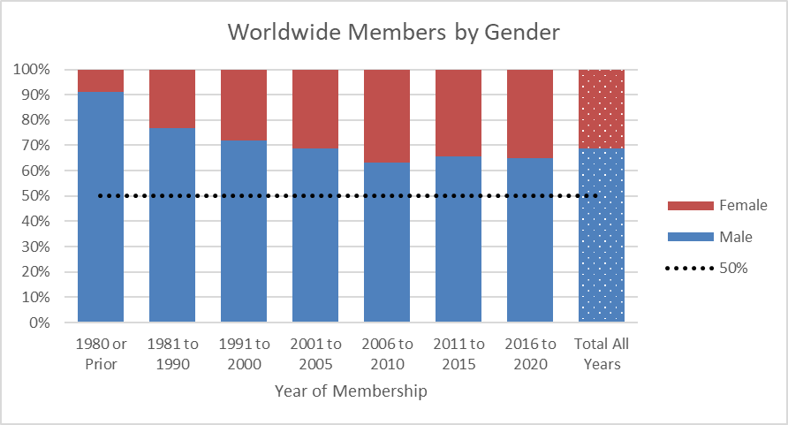
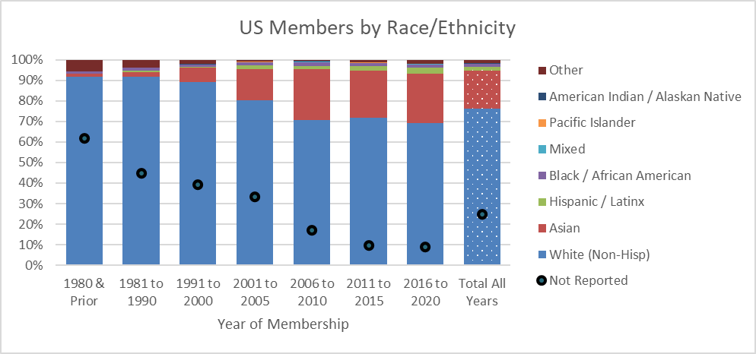
CAS Member Demographics Over Time
Notes:
While we’ve significantly improved in gender balance since the 1980’s the trend stalled in the last 15 years, with new members steadily coming in around 35% female.
We’ve also seen significant demographics shifts in race/ethnicity over the years. Note this is US-only, so we’ve taken out the growth in the Asia region and we still see a big increase in the percent of Asian members in the US, while other minority groups like Black, Hispanic, Native American, and Pacific Islander have not grown the way we’d like them to.
One going note is that new members are reporting their race/ethnicity at higher rates (only 10% not reported for new members in latest 10 years) – so we are able to more reliably track this information for members.
Candidates data is not shown here
reasonably well-reported for gender and we see the same split around 65/35, no distinct trend
Poorly reported for Race/Ethnicity, so it’s not a reliable metric to see how we’re changing, but we’re working on fixing that now.
FAQ – Why do we only show US members in this chart?
A1: We have seen significant growth internationally in the Asia region, which increases the proportion of total members who identify as Asian. We don’t want to look at growth in overseas members as a problem or solution to our local challenges.
FAQ - Why not show North America (US/Canada)?
A: The benchmark employment statistics we have are from the US Census as well as the National Center for Education Statistics. Because those are US-focused, it is best to compare to members working in the US. Canadian racial/ethnic demographics are very different than the US – higher proportion of Asians, smaller proportion of Hispanic Latino. Adding a similar Canadian comparison is one of the enhancements we’re working on now.

Slide 33
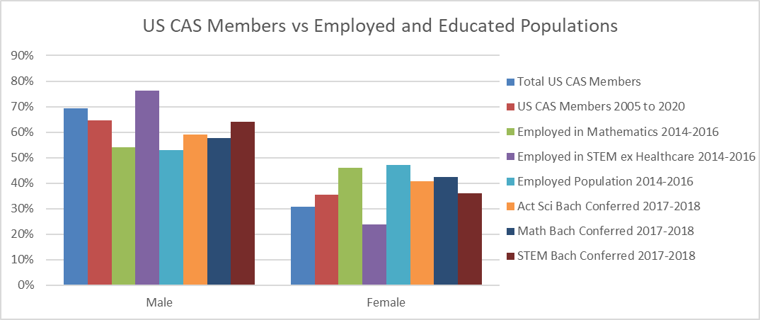
US CAS Members vs Benchmarks
Notes:
Compared to people employed in the Mathematics field, as well as recent graduates from STEM and Math Bachelors programs, women are underrepresented in US CAS membership – even in just new members in the past 10 years.
The reason Employed in STEM looks so different is because engineering field is highly skewed male (around 85% male).
FAQ – Why do we only show US members in this chart?
A: The benchmark employment statistics we have are from the US Census as well as the National Center for Education Statistics. Because those are US-focused, it is best to compare to members working in the US.

Slide 34
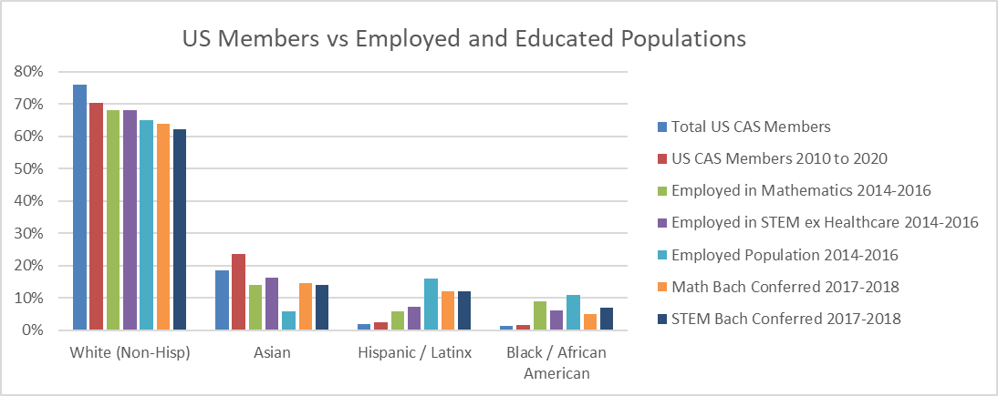
US CAS Members vs Benchmarks
Notes:
Similarly, Black and Hispanic groups are underrepresented in the CAS compared to Math and STEM – both people working in the field and those recently receiving degrees in those fields.
This suggests that when we say there’s a “pipeline problem” it’s an oversimplification – other related fields are doing a better job of attracting these candidates than we are.
FAQ – Why do we only show US members in this chart?
A1: We have seen significant growth internationally in the Asia region, which increases the proportion of total members who identify as Asian. We don’t want to look at growth in overseas members as a problem or solution to our local challenges.
FAQ - Why not show North America (US/Canada)?
A: The benchmark employment statistics we have are from the US Census as well as the National Center for Education Statistics. Because those are US-focused, it is best to compare to members working in the US. Canadian racial/ethnic demographics are very different than the US – higher proportion of Asians, smaller proportion of Hispanic Latino. Adding a similar Canadian comparison is one of the enhancements we’re working on now.

Slide 35
Basic Education Initiatives
Notes:
Finally, we make our members sought after by evolving our basic education program – how we prepare our members of the future.

Slide 36
Basic Education – CBT
Current focus is on a safe and positive exam experience for Fall 2020
Exam results are planned to be released in Q1 2021
Our goal is to get these out as early as possible
Spring 2021
All exams, including Exam 8, will be given
No dates for exams for 2021 yet; these will be communicated as soon as they are confirmed
Keep watching CAS website for more details as they are available

Slide 37
Basic Education – Other Initiatives
CAS hired Chief Learning Officer – Jennifer Naughton
Development of a Multi-Year Admissions Road Map
Job Task Analysis
Notes:
In May 2020, the CAS hired Jennifer Naughton, an association executive with over 25 years of experience in workforce certification, training and competency modeling, to become the organization’s first Chief Learning Officer. According to the announcement released by the CAS, Jennifer will plan, direct, develop, and execute strategies in credentialing and professional education to build learning and assessment vehicles that are cutting edge, innovative, and leverage the most highly regarded cognitive and advanced learning and competency tools in today’s market.
A couple of things that Jennifer is focused on in her first few months on the job, besides the Fall exam sitting, is the development of the admissions road map and the job task analysis.
The road map is a multi-year plan for the admissions/education function. The intent of the roadmap is to articulate goals to external stakeholders to allow them to more effectively anticipate and plan for changes that are to occur.
The core of the job task analysis was a survey that seeks to define the key competencies required of Associates and Fellows and asked about tasks involved in members day-to-day actuarial work. The JTA is critical to the CAS's future admissions efforts — the answers we received will help ensure the relevance of CAS's credentialing curriculum for future actuaries.
Much more detail on these two projects will be shared in 2021.

Slide 38
CAS Basic Education: In Summary
Constantly being adapted and refreshed
Emergence of new risks and coverages
New era of big data and related methods
Evolving expectations from candidates on how educational content is delivered and tested
Activities of other organizations
Notes:
As was evidenced by the topics just discussed, a core principle of the CAS education system is that it needs to continue to evolve and be refreshed over time.
-The economy continues to evolve in new ways, and insurance and risk management is critical to that evolution. Therefore, we need to equip our new actuaries with the right skills and business context to be able to help solve those problems.
-We have more data than ever, and tools more powerful than we could have imagined. They enable the actuary to dig deeper than ever before in search of insights to drive business decisions.
-The candidates of today have grown up learning in different ways. Our one size fits all approach from the past is no longer as relevant and needs to move forward.
-Competition is hotter than ever – not just from other actuarial organizations but from adjacent industries and disciplines looking for smart, motivated analytical talent. Keeping on top of trends and how to best prepare candidates needs to be at the forefront to ensure we have a vibrant pipeline of actuaries in the CAS going forward.

Slide 39
International Initiatives
Notes:
And how are we expanding globally? Here is an overview of our international initiatives….

Slide 40
International Initiatives
Exam 6-International
Developing an international version of the nation-specific regulatory exam.
International Events
Sponsoring or contributing speakers to an increasing number of international events
International Webinars
Offering free webinars for members working internationally; first one held in 2019 on IFRS 17
China-Based Staff Actuary
Hired Ran Guo, FCAS, as Director of International Relations
Notes:
Exam 6-International
Developing an international version of the nation-specific regulatory exam, so that international students are not required to sit for either the US or Canadian versions
International Events
Sponsoring or contributing speakers to an increasing number of events, particularly in developing markets such as Asia and Latin America
International Webinars
Offering free webinars to CAS members working internationally, with the first one hosted on 30 April on IFRS 17
China-Based Staff Actuary
Hired Ran Guo, FCAS, as Director of International Relations, to strengthen and engage the community of actuaries in China and the Asia region.

Slide 41
2020 International Strategy
Target member, candidate, and/or revenue growth where we have the best opportunities for success.
Identify a small number of countries and develop tactics to grow there, and develop scorecards to ensure we’re meeting our objectives.
Notes:
The Board has had discussions over the past year on our international strategy going forward, and there is a bit of a shift taking place.
Whereas in the past we’ve been focused on being good global citizens by responding to requests for assistance, without an explicit goal to grow in specific regions and instead allowing that to happen organically, the Board has now directed a more proactive approach.
The Board has provided the direction you see here:
Target member, candidate, and/or revenue growth where we have the best opportunities for success.
Identify a small number of countries and develop tactics to grow there, and develop scorecards to ensure we’re meeting our objectives.

Slide 42
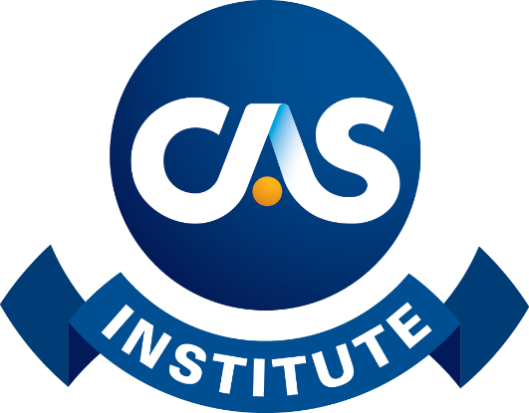
The CAS Institute: Offering Credentials in Predictive Anaytics/Data Science and Catastrophe Risk Management
Notes:
Finally, I wanted to provide an update on The CAS Institute…

Slide 43
The CAS Institute Facts & Figures
> 400 Members
≈ 200 Companies
> 10 Countries Represented
Over 270 CSPAs Awarded
Over 75 CCRMPs Awarded

Slide 44
What credentials are being offered?
Certified Specialist in Predictive Analytics
Catastrophe Risk Management Credentials
Two Levels:
Certified Specialist in Catastrophe Risk
Certified Catastrophe Risk Management Professional

Slide 45
CSPA Credential Requirements:
Overview of Assessments
Property - Casualty Insurance Fundamentals
Data Concepts and Visualization
Predictive Modeling – Methods and Techniques
Case Study Project: P&C Predictive Modeling Application
Online Course on Ethics and Professionalism

Slide 46
Catastrophe Risk Management Credentials
Tier 1 – Working Knowledge
Certified Specialist in Catastrophe Risk (CSCR)
Tier 2 – Advanced
Certified Catastrophe Risk Management Professional (CCRMP) – for senior catastrophe risk managers
Notes:
These two levels were designed to acknowledge the skills and work experience required to distinguish working knowledge to understand & use Catastrophe models appropriately within underwriting, actuarial and risk management functions.
The first level is intended to recognize those individuals who have hands on experience working with using CAT exposure data and model results for either insurers, reinsurers and/or brokers.
The second tier is intended to recognize advanced skills and experience through more detailed use of CAT models, managerial responsibilities of running CAT analytics units and senior risk management responsibilities within an organization.
As we’ll discuss later in the presentation, Exams for Tier 1 credential are being developed. Once Tier one exams are finished, work will begin on Tier 2 exams. Until the tier 2 exams are finalized, experienced industry practitioners will have an interim pathway to obtain a tier 2 credential which will be outlined in more detail in a subsequent slide.
While the initial 2 credentials are focused on the practice of CAT Risk Management, we’ve also made an allowance for a similar, advanced credential to recognize experts within our profession who may not practice CAT Risk Management functions directly. Discussions are in the early stages for the placeholder designation noted here as Certified Catastrophe Risk Model Builder.
Once the high level syllabus for the CAT Risk Management credentials was adopted, both the ISCM and iCAS began soliciting subject matter experts to develop more detailed learning objectives related to each exam.
Stephen Mildenhall from iCAS and St. John’s university began training seminars for the first subject matter experts. We’ll discuss the subject matter specialists more a little later in the presentation.
In closing, it’s important to note that the curriculum was established and intended to be model agnostic and the subject matter specialists have included employees from cat modeling companies. As the exams mature, the focus will expand to address more worldwide perils and world wide insurance market issues.

Slide 47
Certified Specialist in Catastrophe Risk (CSCR)
Goal: Understand how Cat models work and how they can be used Four (4) Exams + Ethics Course
Property Insurance Fundamentals​
Insurance & Reinsurance
Catastrophe Risk Fundamentals
History of Cat Models, Exposure Data, Introduction to Application of Models​
Catastrophe Modeling​ Methodology
Hazard & Vulnerability​
Wind Methodology
EQ Methodology
Introduction to Catastrophe Risk Management
Using Cat Models, Best Practices, Understanding Results, Working with Modeling Output Data

Slide 48
Certified Catastrophe Risk Management Professional (CCRMP)
Goal: Demonstrate advanced applications of catastrophe risk management​ Anticipated Topics:
Advanced Concepts​
Statistics​
Financial Modeling​
Capacity Allocation​
Advanced Applications​
Customizing Model Results
Construction of Cat Models
Use of Models in Risk Management

Slide 49
Questions and Discussion
TheCASInstitute.org
CatRiskCredentials.org

Slide 50
Questions and Your Input
Comments on the CAS’s strategic priorities?
Other questions or comments?
Notes:
Now, what additional questions do you have?
I’m also very interested in your comments on our 2020 strategic priorities. What else should we be focused on?
And with that, I’ll open it up to the audience for questions.

Slide 51
Questions and Discussion

