Slide 1
Towards open collaboration in insurance analytics
CAGNY 2020
@kasaai_

Slide 2
Amuse-bouche
About me!
Kevin (he/him)
Currently: Director of Insurance Practice (sales + open source development) @RStudio
Formerly: Trader, actuary, consultant, “data scientist”, software engineer

Slide 3
Amuse-bouche
About me!
Ryan (he/him)
Currently: Actuary/Data Scientist/Software Dev in Core Analytics @Willis Towers Watson
Formerly: EY, PartnerRe, AmTrust

Slide 4
Legal Disclosure
The views expressed here are our own and they do not necessarily reflect the views of our employers or the CAS.

Slide 5
Menu of the day
Who we are / What we do
Château Kasa, Blanc de Blancs, “Le Rêverie”, NV
Lessons learned / Discoveries / Tips
Bad Joke Cellars, Red Blend, “The Cynic”, 2012
A sampling of projects
Dr. Brandstiftung, Riesling S.G.N., “Einladung”, 1990

Slide 6
Menu of the day
> Who we are / What we do
Château Kasa, Blanc de Blancs, “Le Rêverie”, NV
Lessons learned / Discoveries / Tips
Bad Joke Cellars, Red Blend, “The Cynic”, 2012
A sampling of projects
Dr. Brandstiftung, Riesling S.G.N., “Einladung”, 1990

Slide 7
Towards open collaboration in insurance analytics
CAGNY 2020
@kasaai_

Slide 8
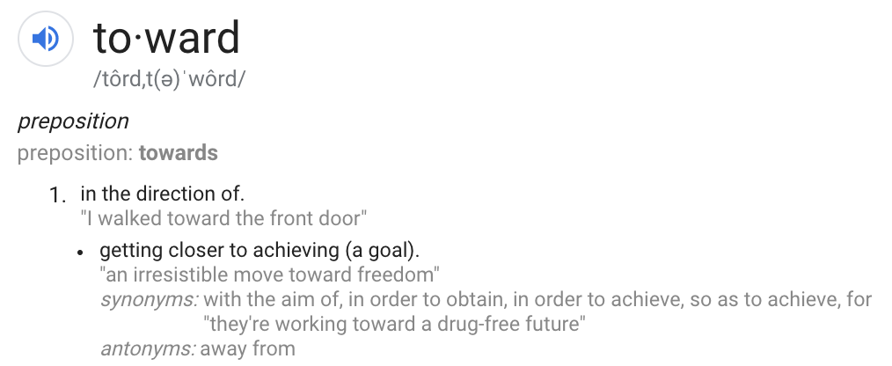
A+ for effort!
Notes:
This is the direction we want to head. We haven’t arrived but we’re on our way.

Slide 9
The (on-going) story of...
Umbrella, because insurance
Japanese for umbrella
AI, for hype
Notes:
Kasa AI is a not-for-profit community-driven initiative for insurance analytics research.

Slide 10
Tl;dr We aspire to be like...
...but for insurance
Notes:
Bioconductor - tools and resources for working with genomics data
Ropen sci - community with creates tools to foster open reproducible science
Tidyverse - a collection of tools for manipulating and plotting data with a common interface
Tools + community

Slide 11
Improve workflows and advance applied AI in insurance through open collaboration

Slide 12
Some Challenges

Slide 13
Notes:
RELIANCE ON FRAGMENTED COLLECTIONS OF PROPRIETARY SOFTWARE
By embracing open source, we can leverage the talent of the entire insurance community to build better tools.
The transparency in both implementation and design decisions enables teams to more effectively utilize the tools and influence development direction.

Slide 14
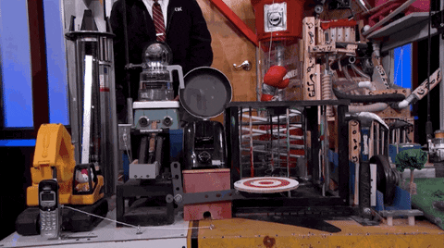
Notes:
BESPOKE PROCESSES
There are considerable commonalities in actuarial workflows.
By developing common tooling based on best practices instead of repeatedly reinventing the wheel, we can focus more on impactful problems.

Slide 15
Notes:
LIMITED ACCESS TO CAPABILITIES
Is it difficult for smaller carriers without significant R&D investments to procure the interdisciplinary knowledge necessary to develop and implement AI projects.
It is also challenging for regulators, who are often resource constrained, to review and approve models based on newer technologies.
By making this knowledge readily available, we encourage greater participation in the feedback and innovation cycle.

Slide 16
The output
Research (reproducible + open)
Software (pkgs & templates)
Educational content (tutorials/blog posts)
Notes:
Conducting applied artificial intelligence research and author papers and blog posts.
Developing open source software to enable adoption of new technologies in practice.
Creating educational material to help teams transition to code-first and reproducible workflows.

Slide 17
Data scientist / software engineer
“Business stakeholders”
Actuary
Notes:
To undertake these activities, we currently depend on time from volunteers, who are professionals and researchers from industry and academia.
Members of the community form teams that serve as core contributors of each project and are responsible for their execution.
An informal network of advisors, who have specific technical expertise or community building experience, assist with everything from coordinating peer review to advocating for the initiative.
We communicate via slack and github

Slide 19
Menu of the day
Who we are / What we do
Château Kasa, Blanc de Blancs, “Le Rêverie”, NV
> Lessons learned / Discoveries / Tips
Bad Joke Cellars, Red Blend, “The Cynic”, 2012
A sampling of projects
Dr. Brandstiftung, Riesling S.G.N., “Einladung”, 1990

Slide 20
#1
Empathy

Slide 21
Acknowledge the Objections

Slide 22
Towards open collaboration in insurance analytics
CAGNY 2020
@kasaai_

Slide 23
Towards open collaboration in insurance analytics
CAGNY 2020
@kasaai_

Slide 24
Towards open collaboration in insurance analytics
CAGNY 2020
@kasaai_

Slide 27
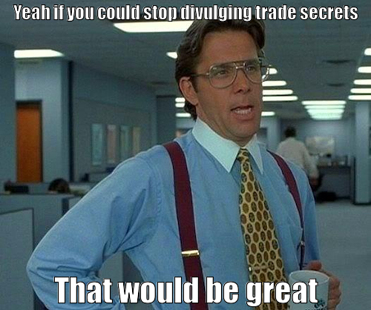

Slide 28
Cultural changes don’t happen overnight!

Slide 29
wins <<- wins + 0.01

Slide 30
wins <<- wins + 0.01
Build critical mass, slowly but surely

Slide 31
wins <<- wins + 0.01
Build critical mass, slowly but surely

Slide 32
Have we gotten there?
How do we define winning?

Slide 33
#2
The needle is moving

Slide 34
#2
The needle is moving
(albeit kinda slowly)

Slide 35
#2
The needle is moving
(albeit kinda slowly)
But it’s moving so it’s all good 😅😅

Slide 36
Kasa AI Blog: Five (5) posts since September 2019

Slide 37
Good things happening:
CAS has a GitHub org! See https://github.com/casact (h/t to Brian Fannin)
Actuarial Data Science still pushing new content https://github.com/JSchelldorfer/ActuarialDataScience (Swiss Association of Actuaries)
Lots of open source R code shipping with actuarial papers (see e.g. Mario Wuthrich https://people.math.ethz.ch/~wueth/papers.html and Ron Richman http://ronaldrichman.co.za/)

Slide 38
More stuff:
IFoA Machine Learning in Reserving Working Party (with open source code/tutorials) https://institute-and-faculty-of-actuaries.github.io/mlr-blog/
OASIS (OSS for cat modeling) gaining traction https://oasislmf.org/
List of other insurance OSS stuff: https://github.com/genedan/actuarial-foss (Maintained by Gene Dan)
Others??

Slide 39
#3
Running open source projects on nights/weekends is hard

Slide 40
#3
Running open source projects on nights/weekends is hard
...especially in 2020

Slide 41
Challenges:
Profile of ideal contributor: someone who
Knows insurance and actuarial methods
Can code
Familiar with AI/ML

Slide 42
Challenges:
Profile of ideal contributor: someone who
Knows insurance and actuarial methods
Can code
Familiar with AI/ML
^^^^^^ probably employed, and busy

Slide 43
How do get more people to contribute to open source in insurance?
What motivates contributors?

Slide 44
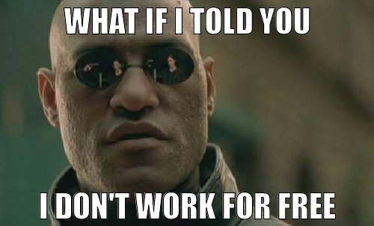

Slide 45
Some ideas (see Gordon Haff’s lightning talk “Why do we contribute to open source?” https://youtu.be/1N2vdjTGPOM)
Mix of intrinsic/extrinsic motivations
$$$
Career advantages
Fun
Altruism (feel-goodness?)
???

Slide 46
#4
Mind the gap

Slide 47
Q3-IBNR-Analysis-v1.xlsx
Q3-IBNR-Analysis-v2.xlsx
Q3-IBNR-Analysis-v2b.xlsx
Q3-IBNR-Analysis-v3-FINAL.xlsx
Q3-IBNR-Analysis-v3-FINAL-REVISED.xlsx

Slide 48
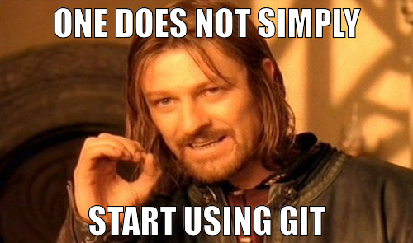

Slide 49
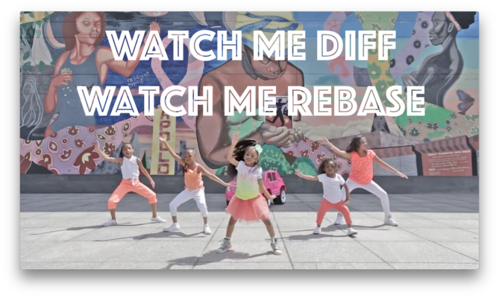
Happygitwithr.com
Tutorials
Etc
Q3-IBNR-Analysis-v1.xlsx
Q3-IBNR-Analysis-v2.xlsx
Q3-IBNR-Analysis-v2b.xlsx
Q3-IBNR-Analysis-v3-FINAL.xlsx
Q3-IBNR-Analysis-v3-FINAL-REVISED.xlsx

Slide 50
> As fun is bleeding edge research is, we should have a healthy focus on educational content!

Slide 51
Menu of the day
Who we are / What we do
Château Kasa, Blanc de Blancs, “Le Rêverie”, NV
Lessons learned / Discoveries / Tips
Bad Joke Cellars, Red Blend, “The Cynic”, 2012
> A sampling of projects
Dr. Brandstiftung, Riesling S.G.N., “Einladung”, 1990

Slide 52
Cellar
Notes:
Address the problem of lack of insurance data to practice with
Show list of Current Available data sets
Mention if you are aware of open insurance data sets which could be added to file an issue on the github page
Tee up example with reference to Meyers monograph
Go to R Studio

Slide 53
Lack of Data
Notes:
frequently cited issues in insurance-related reproducible research and open source software development is the scarcity of publicly available datasets.
Contract to image or language research, where there are many publically available datasets for beginners to use.

Slide 54
Cellar
https://cellar.kasa.ai
Community-curated open datasets for insurance analytics
Notes:
However, we believe that there is an interesting collection of datasets that exist on the Web today that is underutilized.
These datasets are found in a variety of places, from websites (of researchers, actuarial societies, and governmental organizations) to self-hosted R packages, and they appear in an even greater variety of file formats and level of documentation.
While folks “in the know” may be familiar with pockets of these resources, discoverability is lacking in the broader community. Through Cellar, we hope to encourage and accelerate knowledge building in the insurance analytics space.

Slide 55
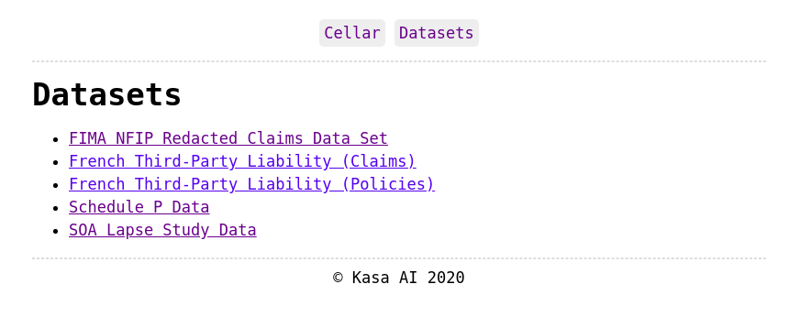

Slide 56
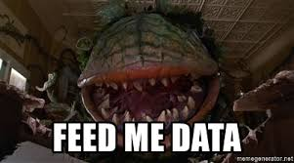
Know about an Open Dataset?
File an issue on the cellar github page
https://github.com/kasaai/cellar

Slide 57
Demo

Slide 58
Notes:
I worked through the paper, building out R models to follow along with the analysis -- I find this is very helpful in understanding what’s going on.
I originally did this pre-cellar and had to do a lot of data manipulation to have data to work with.
Cellar makes it easy
Go to R Studio
Code available at https://github.com/actuarialvoodoo/cellar-demo

Slide 59
Cellar Demo Code Available at: https://github.com/actuarialvoodoo/cellar-demo

Slide 60
Demos on synthesizing data
Code will be available on https://github.com/kevinykuo/cagny-demo sometime after the talk
Notes:
I worked through the paper, building out R models to follow along with the analysis -- I find this is very helpful in understanding what’s going on.
I originally did this pre-cellar and had to do a lot of data manipulation to have data to work with.
Cellar makes it easy
Go to R Studio

Slide 61
Get involved!
Hibernating projects
P&C pricing tutorial https://github.com/kasaai/pc-pricing-tutorial (ultimate deliverable: https://ratemake.com/)
{rsvr}: a data frame-oriented package for loss reserving https://github.com/kasaai/rsvr
Other stuff??

Slide 62
The invite
Please connect if you are
Insurance student/professional at all interested in R/Python/open source
Interested in helping out in any way

Slide 63
The invite
Please connect if you are
Insurance student/professional at all interested in R/Python/open source
Interested in helping out in any way
Or not!
Can also start your own repo, get your company to run an open source GitHub org, contribute to github.com/casact, etc.

Slide 64
Cheers!
Resources
github.com/kasaai
kasa.ai / blog.kasa.ai
slack.kasa.ai
Hit us up
@kasaai (github, linkedin)
@kasaai_(twitter)

